Slide 1

UNIX and Shell Programming concepts
Date : 13th – 17th Mar-2022
Presenter : SUMIT CHAUDHURI CX - CLIENT EXPERIENCE

Slide 2
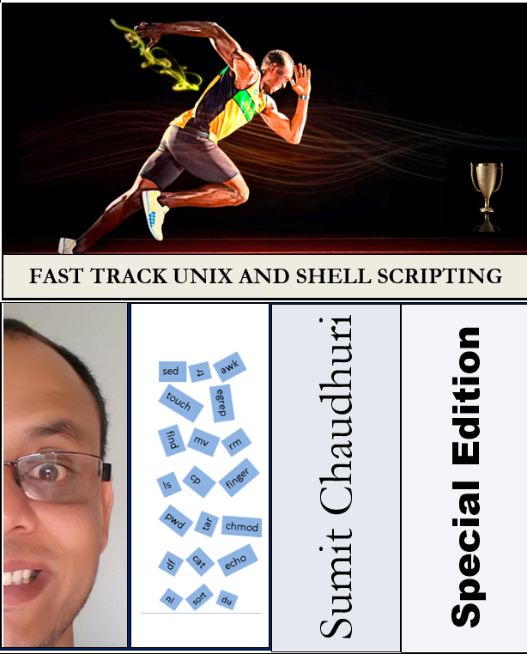
ABOUT ME
SUMIT CHAUDHURI
 | More than 20 years of experience using Unix and Shell Scripting along with other technologies Worked on various domains like Utility Billing, Telecom, Supply Chain/ WMS, Healthcare and Life Insurance Countries and organization worked - US, Indonesia, India and with big MNCs like SIEMENS, Keane, VeriSign, Convergys, FIS, etc Various manual processes have been automated through Shell Scripts and got awarded for the Innovation More than 800+ hours of training has been conducted Active participant on various Unix forums Working on my Unix eBook

Slide 3
AGENDA
To cover ‘Unix Fundamentals and Shell Scripting’ (Unix as a User not as an Administrator)
User – Design, develop and implement applications appropriate to business needs and requirements. Interface with customers to identify and understand their business goals. Perform analysis and evaluation of customer requirements. Example: A User automates a business processes using shell scripts, Java and Oracle
Administrator - As a Unix System Administrator, person is responsible for the installation, configuration, and maintenance of UNIX systems. In this role, administrator will troubleshoot server errors, install new system hardware, respond to user issues, and monitor the performance of the network. Example: Administrator maintains Unix system and installed applications like Java, Oracle etc in the Unix machine.
To cover little bit about Unix Advanced Commands Like awk, sed, tr, tar, dd, bc etc.
Will not cover much about theoretical part and history of Unix or something similar topics. Example: The development of Unix started around 1969 at AT&T Bell Labs by Ken Thompson and Dennis Ritchie, and details and history will not be covered here
Disclaimer: I may not know the answer to every questions, but I will try my level best to explain all the topics mentioned in the PPT.

Slide 4
CONTENTS
Unix Overview ( Slide 1 – 10)
Unix Commands
Advanced Unix
Shell Programming
At the end we will automate a manual process via shell scripting
Questions and Answers

Slide 5
UNIX OVERVIEW (MULTI-USER/ MULTI-TASKING)
More than one user can run multiple jobs at the same time and more than one task can be run at the same time
Unix is multi-user/ multitasking
In Unix, each task is started with a process with a unique process ID (PID)
Usually only one copy of a program, but there may be many processes running the same program
To each interactive user (window/ terminal):
only one process in foreground
may have several processes in background

Slide 6
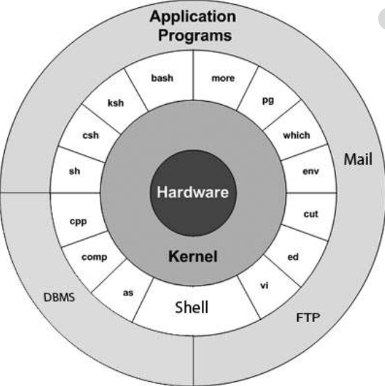
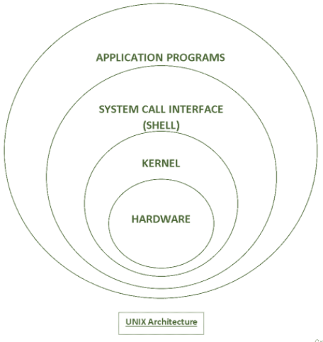
HOW DOES UNIX WORK?
Unix has a kernel and one or more shells
The kernel is the core of the OS; it receives tasks from the shell and performs them. The shell is the
interface to the user. User gives command to the shell. Shell interprets the command and pass it to kernel
with appropriate system call.

Slide 7
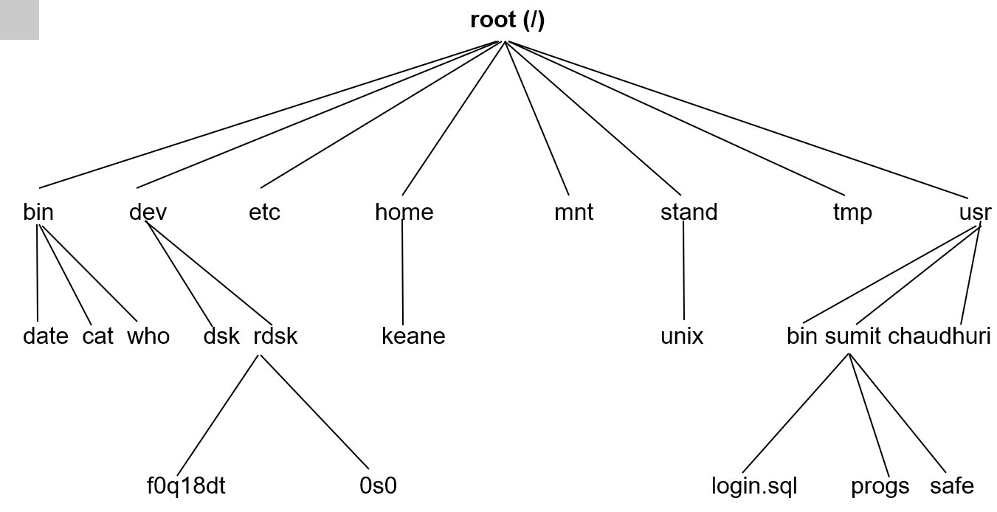
UNIX FILE SYSTEM

Slide 8


LET’S TALK MORE ABOUT UNIX
Note: Unix is a case sensitive, so be careful while giving commands.

Slide 9
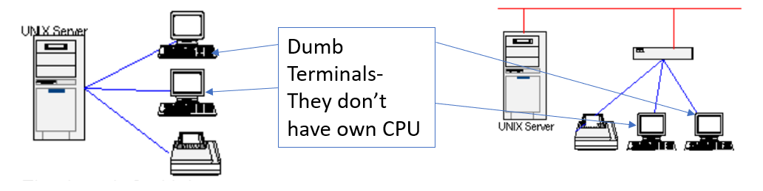
UNIX LOGIN
Via Unix dumb terminal Some terminals are referred to as "dumb" terminals because they have only the minimum amount of power required to send characters as input to the Unix system and receive characters as output from the Unix system.
OR
Connected via wireless
Connected via wire

Slide 10
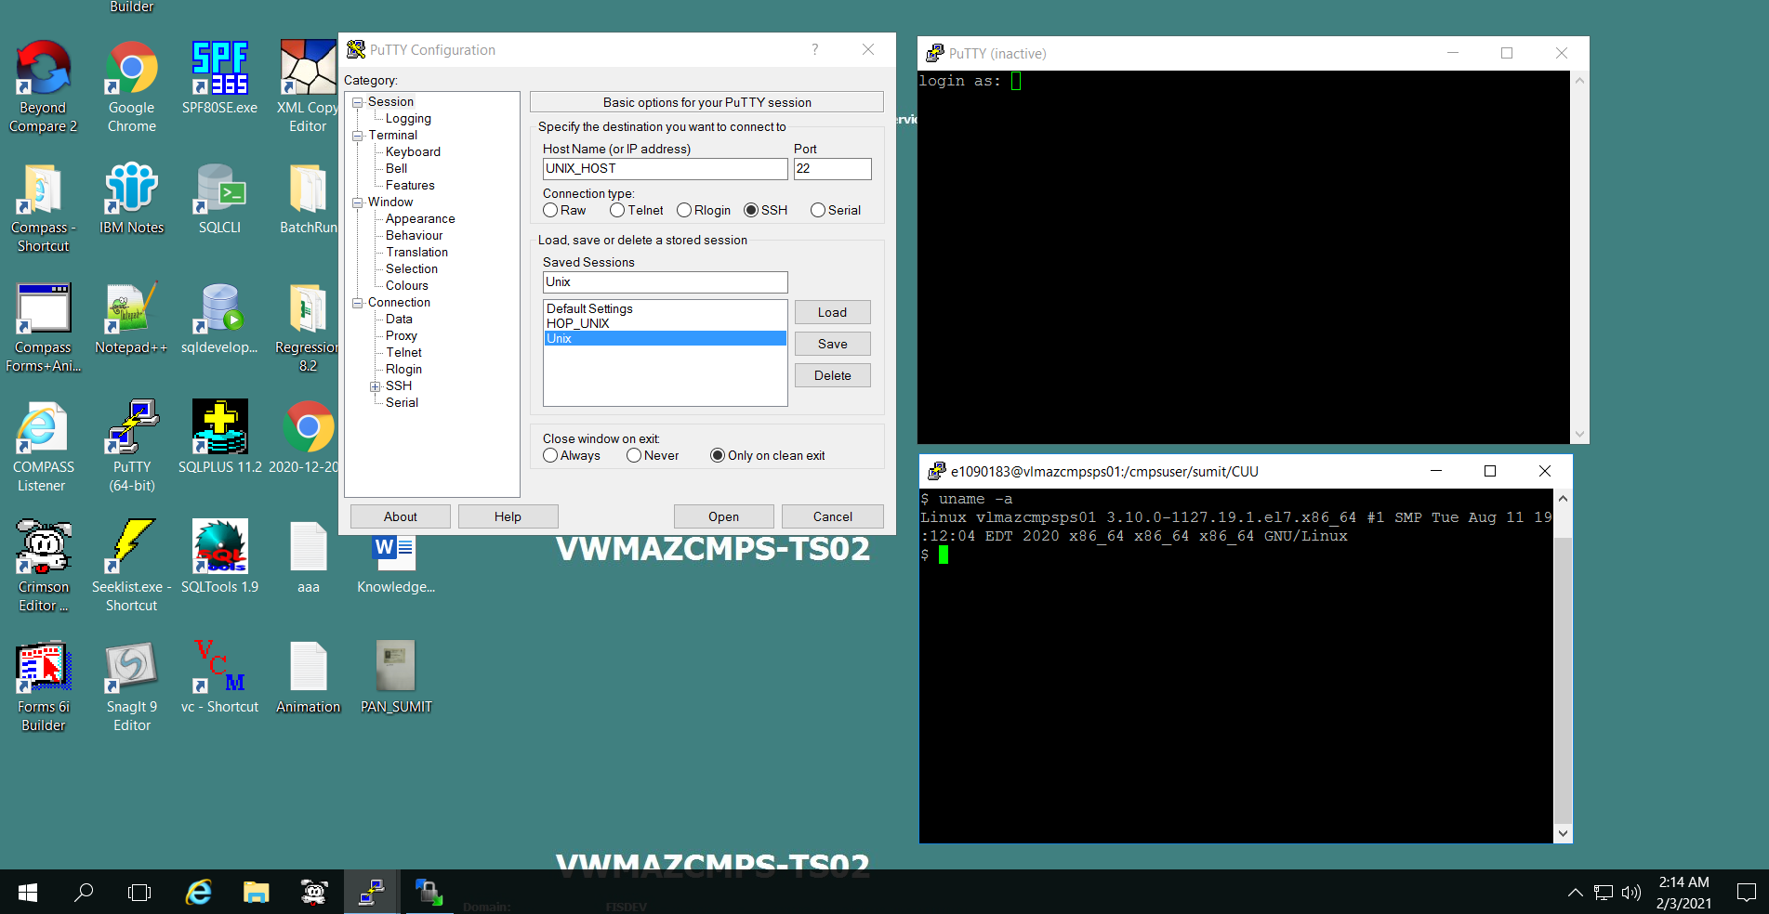
UNIX LOGIN
Via Windows terminal There are many emulators available for Windows to connect with Unix machine. PuTTy, ReflextionX, HummingBird, Telnet etc. Below screen shot is an example of Putty connection with a Linux box.
Windows
Putty
Login credentials
Successfully connected with Linux

Slide 11
UNIX COMMANDS (mkdir, rmdir, man)
Command - mkdir
Description - Creates one or more new directories
Example - mkdir test or mkdir test1 test2 or mkdir /home/user/mydir
Note: To make a new directory you must have write permission in the parent directory.
Command - rmdir
Description - Removes a directory
Example - rmdir test
Note: Make sure that directory should be empty. More details will be explained under ‘rm’ command
Command - man or --help
Description - An interface to the on-line reference manuals.
Example - man man, man mkdir, man rmdir or cp --help

Slide 12
UNIX COMMANDS (cd, pwd)
Command - cd
Description - Changes the current directory
Example - cd or cd test or cd /home/user/mydir
Note: It should have execute (search) permission in the specified directory.
Command - pwd
Description - Displays the path name of the working directory
Example - pwd

Slide 13
UNIX COMMANDS (clear, touch, date)
Command - clear
Description - Clear the terminal screen
Example - clear
Command - touch
Description - Updates the access and modification times of a file. It also creates a zero-byte file if it does not exist.
Example - touch myfile (if does not exist – New file, if exists - Overwrite) or touch -c -t 201501011212 myfile [ yyyymmddhhmm]
Command - date
Description - Displays or sets the date or time
Example - date or date +%m%d%Y%H%M%S or date --date='30 days ago' ‘+%m %d'

Slide 14
UNIX COMMANDS (ls)
Command - ls
Description - Displays the contents of a directory
Example - ls or ls filename or ls directory
Illustrations $ls -l myfile.dat -rw-rw-r-- 1 sumit site1 4 Jan 14 02:32 myfile.dat
Flags
Arguments
Flags change the behavior of the command.
Arguments define the scope of the command.

Slide 15
UNIX COMMANDS (ls Contd…)
-rw-rw-r-- 1 sumit site1 4 Jan 14 02:32 myfile.dat
Note: If the first character is:
d The entry is a directory.
b The entry is a block special file.
c The entry is a character special file.
l The entry is a symbolic link, and either the -N flag was specified, or the symbolic link did not point to an existing file.
p The entry is a first-in, first-out (FIFO) special file.
s The entry is a local socket.
- The entry is an ordinary file.
Permissions are indicated as follows: r Read w Write (edit) x Execute (search)

Slide 16
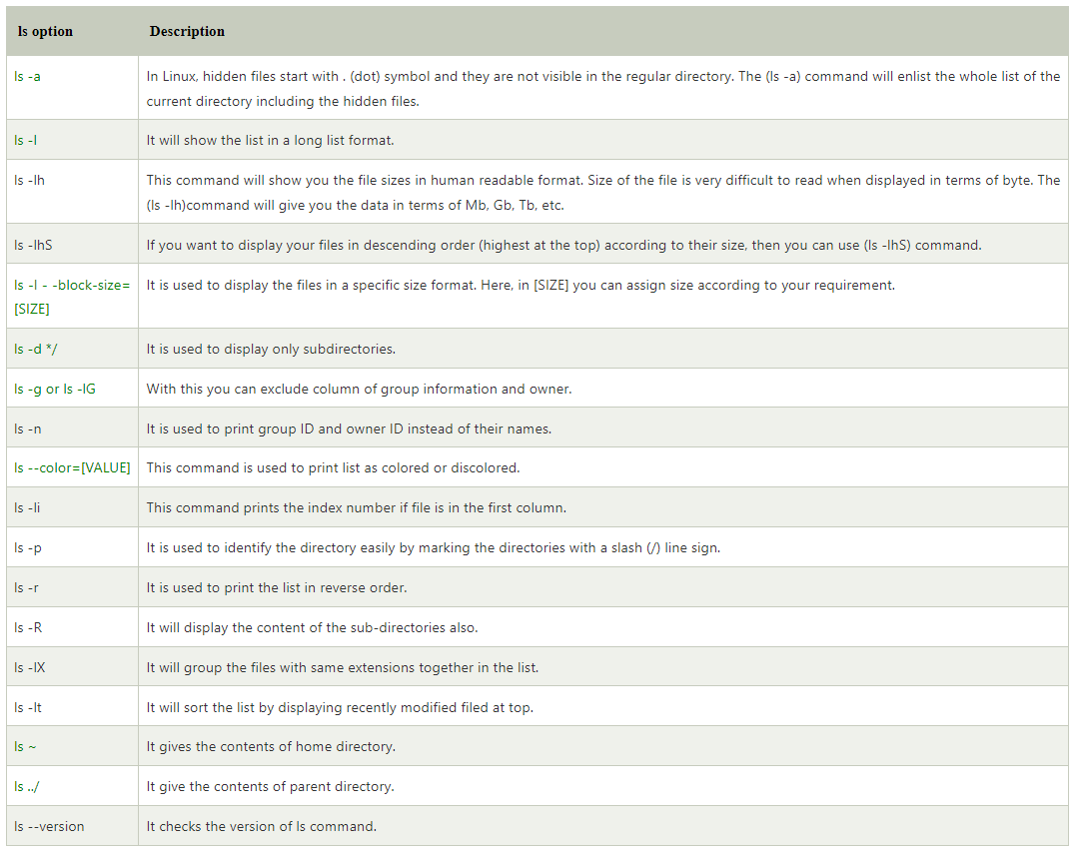
UNIX COMMANDS (ls Contd…)

Slide 17
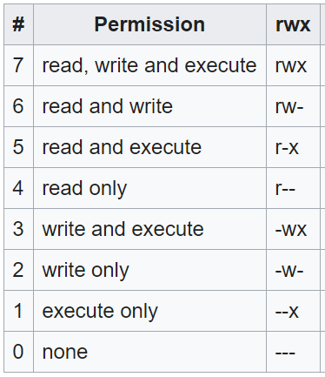
UNIX COMMANDS (chmod)
Command - chmod
Description - Changes file modes (permission). Modes can be changed Symbolically as well as by Numerically
Example - chmod +x myfile or chmod +w myfile or chmod –r myfile or chmod 421 myfile or chmod 777 myfile or chmod –R 777 mydir
Note :The first set of flags specifies who is granted or denied the specified permissions, as follows:
u File owner. g Group and entries pertaining to the file's group. o All others. id <user> [ It tells user belongs to which group] | 4 Read 2 Write 1 Execute 0 None

Slide 18
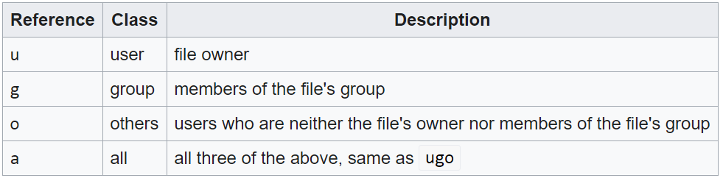
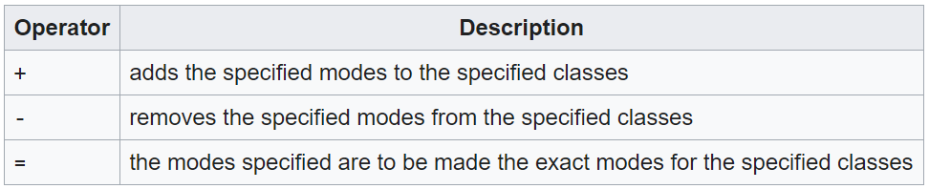
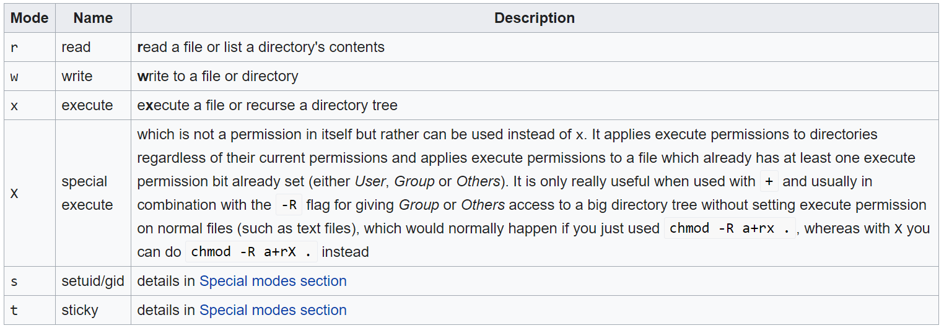
UNIX COMMANDS (chmod…Contd)
chmod [references][operator][modes] file ...

Slide 19
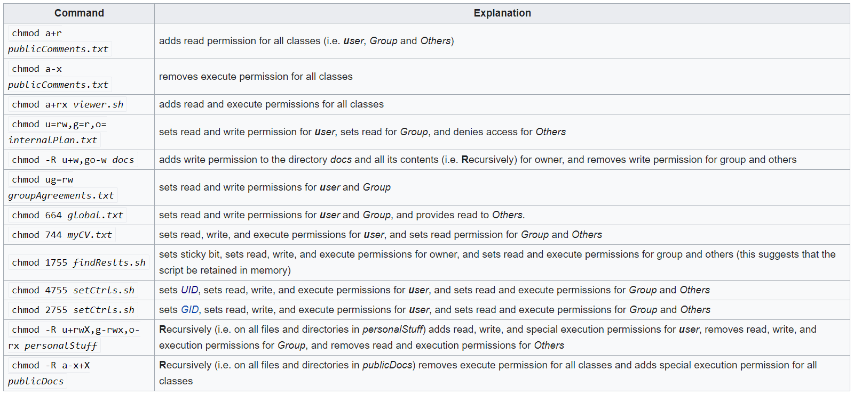
UNIX COMMANDS (chmod…Contd)

Slide 20
UNIX COMMANDS (chown, chgrp)
Command - chown
Description - This command allows you to change the user and/or group ownership of a given file or directory
Example - -rw-r--r-- 12 sumit users 12.0K Apr 8 20:51 filename.txt Group Owner chown training filename.txt -rw-r--r-- 12 training users 12.0K Apr 8 20:51 filename.txt
Command - chgrp
Description - This command is used to change the group ownership of a file or directory directory
Example - -rw-r--r-- 12 sumit users 12.0K Apr 8 20:51 filename.txt chgrp training filename.txt
-rw-r--r-- 12 sumit training 12.0K Apr 8 20:51 filename.txt

Slide 21
UNIX COMMANDS (umask, uname)
Command - umask
Description - Umask is a C-shell built-in command which allows you to determine or specify the default access (protection) mode for new files you create
Example - $ ls –l filename.txt -rw-r--r-- 12 sumit users 12.0K Apr 8 20:51 filename.txt umask 000 echo “Creating a new file to test umask command” > filename.txt $ ls –l filename.txt -rw-rw-rw- 12 sumit users 1.0K Jan 18 11:34 filename.txt Note: It subtracts from 0777 and set the permissions accordingly. Execute permission can not be set on files.
Command - uname
Description - Print system information
Example - $ uname –a Linux vlmazcmpsps01 3.10.0-1160.49.1.el7.x86_64 #1 SMP Tue Nov 9 16:09:48 UTC 2021 x86_64 x86_64 x86_64 GNU/Linux

Slide 22
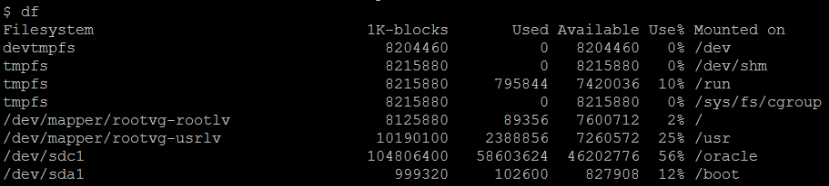
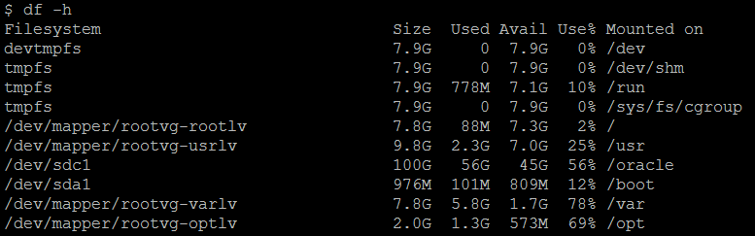
UNIX COMMANDS (df)
Command - df
Description - Reports information about space on file systems
Example - df or df . or df –h

Slide 23
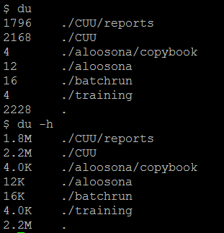
UNIX COMMANDS (du)
Command - du
Description - Summarizes disk usage
Example - du or du . or df –h

Slide 24
UNIX COMMANDS (I/O Redirection)
Redirection and Pipe
“>“ redirects standard output (screen) to a file e.g. ls > dirlist
“<“ redirects standard input (keyboard) from a file e.g. sort < infile > outfile
“|” pipe output of program 1 to input of program 2 e.g. ls -l | wc -l
“>>“ appends output to a file e.g. ls -l >> oldfile

Slide 25
UNIX COMMANDS (vi Editor)
King of all editors
vi editor

Slide 26
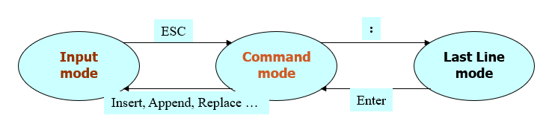
UNIX COMMANDS (vi Editor)
Mode of operation The Work Buffer
During the editing session, vi makes all changes in the buffer

Slide 27
UNIX COMMANDS (vi Editor) - Loading and Saving Files
vi [filename] - start vi ( edit filename)
vi +[number, /string] - begin with start line, first matching string, relatively
:e filename - edit filename
:q - terminate vi without saving
:q! - terminate vi, leave file unchanged
:w - save edited file, stay in vi
:r filename - read in text in filename

Slide 28
UNIX COMMANDS (vi Editor) - Command Mode - Moving the Cursor
l,h,j,k - move right, left, down, up
w,b,e - move right one, left one, to end of word
W,B,E - equivalent above except the space delimited word
-,Enter - move start of upper line, start of next line
^,$ - move start of line, end of line
<crtl>+u,d,b,f - move screen one half-page up, one half page down, one page up, one page down in text
H,M,L - move left end of top, middle line, bottom line
G - move to last line
nG - move to nth line

Slide 29
UNIX COMMANDS (vi Editor) – Input Mode
i - insert before the cursor
a - append after the cursor
o - insert the text on a new line after the current line
r - replace the current one character, automatically return to command mode
I - insert the text at start of line
A - insert the text at end of line
O - insert the text on a new line before the current line
R - overwrite all character until press <ESC>
<ESC> - return to command mode

Slide 30
UNIX COMMANDS (vi Editor) – Command Mode – Deleting Text
x - delete the character under the cursor
dw - delete to the of word
dW - delete to end of space delimited word
D - delete to end of line
dd - delete the current line
u - undo the last change made
U - restore current line to previous state

Slide 31
UNIX COMMANDS (vi Editor) – Command Mode – Changing Text
cw - change to end of word
cb - change to begin of word
cW - change to end of space delimited word
cB - change to begin of space delimited word
cc - change the current line

Slide 32
UNIX COMMANDS (vi Editor) – Searching for a string
The Search Commands
/fis - search forward for text string fis
?fis - search backward for text string fis
/ - repeat search forwards
? - repeat search backwards
n - repeat search in same direction
N - repeat search in opposite direction

Slide 33
UNIX COMMANDS (vi Editor) – Searching for a string…Cont…
Special Characters in Search Strings
^ - the beginning-of-line indicator
$ - the end-of-line indicator
. - the any character indicator
\> - the end-of-word indicator
\< - the beginning-of-word indicator
[ ] - the character class definition

Slide 34
UNIX COMMANDS (vi Editor) – Substituting One String for Another
[address]s/search-string/replace-string[/g]
address
number - line number
77,100 - line 77 through 100
1, . - the beginning of the work buffer through the current line
.,$ - the current line through the end of work buffer
1,$ - the entire work buffer
% - the entire work buffer
.,.+10 - the current line through the tenth following line

Slide 35
UNIX COMMANDS (vi Editor) – Miscellaneous Commands
J - join command
<ctrl>-g - status command (line number of current line, total number of line)
End line mode - :f
. - period command (repeat the most recent command that made a change)
~ - tilde command (change between lowercase and uppercase)

Slide 36
UNIX COMMANDS (vi Editor) – The Put, Delete and Yank Commands
y - yank command
yy, Y - yank the current line
nyy, nY - yank the n line from current line
p - paste the text on a new line after the current line
P - paste the text on a new line above the current line
dd- deletes the current line
ndd- delete n lines from the current line

Slide 37
UNIX COMMANDS (vi Editor) – Reading and Writing Files
Read Command
:[address]r [filename]
Write Command
:[address]w[!] [filename] - overwrite mode
:[address]w>>filename - append mode
address - the same as substitution command

Slide 38
UNIX COMMANDS (vi Editor) – Examples
vi myfile (If file does not exist, it will open as a new file)
vi myfile (If file exits, it will open)
vi +25 myfile (File will open in edit mode and cursor will directly go to line no. 25, if exists)
vi +R myfile (File will open in READ ONLY mode)

Slide 39
UNIX COMMANDS (cp, mv)
Command - cp
Description - To Copy a File to another File
Example - cp myfile yourfile or cp myfile /home/mydir/. or cp –i myfile /home/user/mydir/. or cp –r dir1 dir2
Note: To make a new file(s) you must have write permission in the parent directory.
Command - mv
Description - Moves files
Example - mv myfile yourfile or mv myfile /home/mydir/. or mv –i myfile /home/user/mydir/.

Slide 40
UNIX COMMANDS (rm, cat)
Command - rm
Description - Removes (unlinks) files or directories.
Example - rm myfile or rm /home/mydir/myfile or rm –f myfile rm –r mydir
Command - cat
Description - Concatenates or displays files
Example - cat myfile or cat myfile myfile2 myfile3 > yourfile or cat /home/user/mydir/myfile or cat –n myfile

Slide 41
UNIX COMMANDS (more, echo, sleep)
Command - more
Description - Displays the contents of files one screen at a time
Example - more myfile or ls –l |more
Command - echo
Description - Writes character strings to standard output.
Example - echo This is my first command or echo “Backup files are:” *.bak echo ${#variable} – Returns the length of the variable
Command - sleep
Description - Delay for a specified amount of time (in seconds)
Example - sleep 30

Slide 42
UNIX COMMANDS (head, tail, finger)
Command - head
Description - Displays the first few lines or bytes of a file or files.
Example - head myfile or head –5 myfile
Command - tail
Description - tail myfile or
Example - tail -5 myfile
Command - finger
Description - Shows user information. The finger command displays information about the users currently logged in to a host.
Example - finger or finger <username>

Slide 43
UNIX COMMANDS (compress, compress, zcat OR pack, unpack)
Command - Compress
Description - Compresses data. The compress command compresses data to reduce the size of files. Each original file specified by the File parameter is replaced when possible by a compressed file with a .Z appended to its name.
Example - compress myfile or compress –f myfile
Command - uncompress
Description - Compressed files can be restored to their original form using uncompress or zcat command
Example - uncompress myfile.Z or zcat myfile.Z
NOTE: Similarly pack or unpack command can be given, .z extension will be appended automatically in pack command.

Slide 44
UNIX COMMANDS (file, strings)
Command - file
Description - Determines the file type
Example - file myfile.exe
Command - strings
Description - Strings prints the printable character sequences that are at least 4 characters long (or the number given with the options below) and are followed by an unprintable character.
Example - strings myfile.exe Note: strings is mainly useful for determining the contents of non-text files

Slide 45
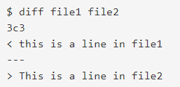
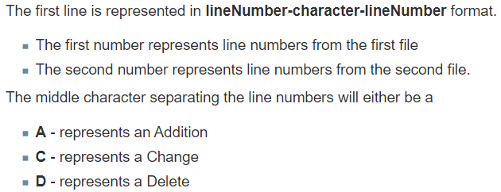
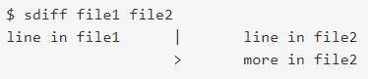
UNIX COMMANDS (diff, sdiff)
Command - diff
Description - Compare two files
Example -
Command - sdiff
Description - Side-by-side comparison. file1 on the left and file2 on the right.
Example -

Slide 46
UNIX COMMANDS (grep, egrep, fgrep)
Command - grep
Description - Grep is a command-line utility for searching plain-text data sets for lines that match a regular expression.
Example - grep “sumit” myfile or grep –ic “sumit” myfile or grep –v “sumit” myfile or
Command - egrep
Description - Extended grep - Search file(s) for lines that match an extended expression.
Example - egrep “sumit|FIS” myfile Note: egrep is the same as 'grep -E'

Slide 47
UNIX COMMANDS (fgrep)
Command - fgrep
Description - fgrep interpret PATTERN as a list of fixed strings, separated by newlines, any of which is to be matched.
Example - Try to understand the usefulness with the below example
Current Issue: A monitoring script which scan the app.log grep the word “ERROR” and send email notification. But many errors can be ignored (false alarms)
$ cat app.log
This ERROR1 can be ignored.
This ERROR2 can be ignored.
This ERROR3 is a dangerous error.
This ERROR4 can be ignored.
This ERROR5 can be ignored.
This ERROR6 can be ignored.
This ERROR7 is a dangerous error.
This ERROR8 can be ignored.
$ cat ignore.list
ERROR1
ERROR2
ERROR4
ERROR5
ERROR6
$ fgrep -v -f ignore.list app.log
This ERROR3 is a dangerous error.
This ERROR7 is a dangerous error.
This ERROR8 can be ignored.
Solution: 1. Create a file and mention all ERROR codes which can be ignored
2. Run the fgrep command and if it returns any ERROR code then only send email notification
3. After investigation if it found the new error can also be ignored, just add that error in the ignore.list file, so the next time that error will also be ignored (So, after this automation only real error code will be notified) (NOTE: This example is based on my past implementation )

Slide 48
UNIX COMMANDS (find, wc)
Command - find
Description - Finds files with a matching expression
Example - 1. find / -name “myfile” –print 2>/dev/null 2. find . -name "*.cob" -print|xargs grep -i “sumit“ 3. find . -name "*.cob" -print -exec grep -i “sumit" {} \; 4. find /opt/backup -type f -mtime +30 5. find /opt/backup -type f -mtime +30 –delete or find /opt/backup -type f –mtime +30 |xargs rm -rf 6. find /opt/backup -name “*.txt” -type f -mtime +30
Command - wc
Description - Counts the number of lines, words, and bytes or characters in a file
Example - wc myfile or wc –l myfile

Slide 49
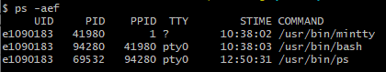
UNIX COMMANDS (ps, kill)
Command - ps
Description - Shows current status of processes
Example - ps –aef
Command - kill
Description - Sends a signal to running processes
Example - kill –9 94280
Process ID

Slide 50
UNIX COMMANDS (who, which)
Command - who
Description - Identifies the users currently logged in
Example - who or who am i
Command - which
Description - Locates a program file, including aliases and paths
Example - which myfile.ksh

Slide 51
UNIX COMMANDS (cut, paste, join)
Command - cut
Description - Writes out selected bytes, characters, or fields from each line of a file
Example - cut –c4-10 myfile.txt or cut –f1 -d”.” myfile.txt
Command - paste
Description - Joins lines from one or more files
Example - paste myfile.txt myfile2.txt
Command - join
Description - Joins the data fields of two files
Example - join myfile.txt myfile2.txt

Slide 52
UNIX COMMANDS (tty, lp, cancel)
Command - tty
Description - Writes to standard output the full path name of your terminal
Example - tty
Command - lp
Description - Sends requests to a line printer
Example - lp myfile.txt
Command - cancel
Description - The cancel command cancels line printer requests that were made by the lp command
Example - cancel <JobID>

Slide 53
UNIX COMMANDS (sort, uniq)
Command - sort
Description - Sorts files, merges files that are already sorted, and checks files to determine if they have been sorted
Example - sort myfile.txt or sort –u myfile.txt or
Command - uniq
Description - Reports unique or duplicate lines in a file
Example - uniq myfile.txt or sort –u or uniq –d myfile.txt or uniq –u myfile.txt
$ cat myfile.txt 001I B 1 SUMIT
002XII D 9 MAHESH
003I A 2 AMIT
004I A 1 BALVINDER
005II A 2 JAGRIT
006III A 1 ROHIT
007II A 1 VIRAT
008II B 3 RAJESH
009II B 4 ZEESHAN
$ sort +0.3 -0.6 +0.8 -0.9 +0.15r -0.25r myfile.txt
004I A 1 BALVINDER
003I A 2 AMIT
001I B 1 SUMIT
007II A 1 VIRAT
005II A 2 JAGRIT
009II B 4 ZEESHAN
008II B 3 RAJESH
006III A 1 ROHIT
002XII D 9 MAHESH

Slide 54
UNIX COMMANDS (tar, tput, split)
Command - tar
Description - Manipulates archives
Example - tar -cvf bak * (For taking backup) or tar -xvf bak (For restoring/ extraction of files)
Command - tput
Description - For Outputting Terminal Information
Example - tput cup 12 12;echo “sumit” or tput sgr 1 1;echo “sumit”
Command - split
Description - Splits a file into pieces
Example - split myfile.txt

Slide 55
UNIX COMMANDS (mailx, bc, uuencode)
Command - mailx or mutt
Description - Sends and receives mail
Example - mail –s “Hello” sumit_chaudhuri@email.com < file_body or mail –s “Hello” sumit_chaudhuri@email.com < /dev/null or mutt –a attach_file –s “Hello” sumit_chaudhuri@email.com < /dev/null (cat log; uuencode log.txt log.txt) | mailx -s "test" sumit.chaudhuri@email.com Note : After uuencode, file name must be given two times
Command - bc
Description - Provides an interpreter for arbitrary-precision arithmetic language
Example - bc <enter> 3 +4 <enter> or 6/2 <enter>

Slide 56
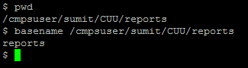
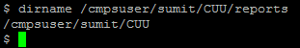
UNIX COMMANDS (basename, dirname, typeset)
Command - basename
Description - Strip directory and suffix from filenames
Example -
Command - dirname
Description - Strip last component from file name
Example -
Command - typeset
Description - Shell built-in functions to set/get attributes and values for shell variables and functions
Example - typeset –l (All upper-case characters are converted into lower-case) typeset –u (All lower-case characters are converted into upper-case)

Slide 57
UNIX COMMANDS (read, nohup)
Command - read
Description - Read from the standard input
Example - 1. echo “Enter password”; read –s -p password Note: -s means ‘do not echo input coming from a terminal’ -p means ‘output the string PROMPT without a trailing newline before attempting to read’ 2. cat inpfile|\ while read LINE do echo $LINE done
Command - nohup
Description - Run a command immune to hang-ups, with output to a non-tty. (No Hang Up)
Example - nohup /home/production/backup.ksh &

Slide 58
UNIX COMMANDS (tee, expr, cal)
Command - tee
Description - Displays the output of a program and copies it into a file
Example - cat myfile.txt | tee myfile.log or cat myfile.txt | tee –a myfile.log
Command - expr
Description - Evaluates arguments as expressions
Example - count=`expr $count + 1` or ctr=`expr $count – 1`
Command - cal
Description - Displays a calendar
Example - cal 01 2005 or cal 2005

Slide 59
UNIX COMMANDS (tr, sed)
Command - tr
Description - Translates characters. The tr command deletes or substitutes characters from standard input and writes the result to standard output
Example - tr ‘a' ‘b' < myfile.txt > outfile.txt or tr 'a-z' 'A-Z' < myfile.txt or tr –d ‘<‘ < myfile.txt
Command - sed
Description - Provides a stream editor. The sed command modifies lines from the specified Fileparameter according to an edit script and writes them to standard output
Example - sed "s/good/bad/g" myfile.txt > outfile.txt or sed ‘/bad/d’ myfile.txt or sed ‘/^$/d’ myfile.txt [delete blank lines] or sed -n ‘3,5p’ myfile.txt [ It will print line number 3rd and fifth] or sed '/^$\|^#/d' myfile.txt [ It will delete blank lines and lines starting with #]

Slide 60
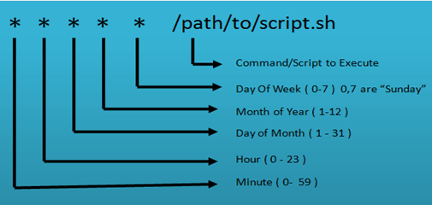
UNIX COMMANDS (crontab)
Command - crontab
Description - A cron job is a command run by the cron daemon at regularly scheduled intervals
Example - 35 * * * * updated [ To run the updatedb command 35 minutes past every hour. ]
00 14 10 3,6,9,12 * /usr/local/bin/diskusage.sh [ To execute /usr/diskusage.sh at 2:00 PM on 10th of March, Jun, Sep and Dec. ]
00 21 * * Mon,Wed,Fri /usr/local/bin/diskusage.sh [ To execute the above script at 9.00 PM every Monday, Wednesday, Friday ]
crontab –l
crontab –e crontab -r

Slide 61
Awk (Aho, Weinberger and Kernighan)
Some useful commands/ tips using awk to get desired output
Suppose file myfile.txt contains 1 sumit chaudhuri 2 kunjal joshi 3 rajesh pandey
awk '/sumit/‘ myfile.txt output 1 sumit chaudhuri
awk '{print $2 " " $3}‘ myfile.txt output sumit chaudhuri kunjal joshi rajesh pandey
awk '{print substr ($0,3,4)}’ myfile.txt output sumi kunj raje

Slide 62
Awk (Aho, Weinberger and Kernighan) Cont…
awk '{print length($0)}‘ myfile.txt output 17 14 16
awk ' {
startdt=substr($0,6,4) substr($0,3,2) substr($0,0,2)
enddt=substr($0,14,4) substr($0,11,2) substr($0,08,2)
if ((startdt == enddt) && (substr($0,50,2) == "01")) {
print $0 > "same_start_end.out"
} else {
if (substr($0,50,2) == "01") {
print $0 > "diff_start_end.out"
}
}
}' tst.txt

Slide 63
Awk (Aho, Weinberger and Kernighan) Cont…
awk '$1==“1" || $1==“3" {print $0}‘ myfile.txt output 1 sumit chaudhuri 3 rajesh pandey
awk '$1>2 {print $0}‘ myfile.txt output 3 rajesh pandey

Slide 64
Unix Shell Programming
What is a shell?
A shell is a command line interpreter. It takes commands and executes them.
Different types of shell available
Bourne shell(/usr/bin/sh), C shell(/usr/bin/csh), Korn shell(/usr/bin/ksh) and others.
Shell Scripts
It implements a programming language and can be used to create programs that are interpreted/executed by the shell.

Slide 65
Unix Shell Programming - Language Constructs
if - conditional execution: Test exit status of command and branch
for - loop iteration: Substitute values for variable and perform task
case – multi way branch: Switch to statements depending on pattern match
while/until - tested iterations: Repeat task while command returns good exit status

Slide 66
Unix Shell Programming Comparison Operators
Numeric Comparisons
Operator Meaning -eq Equal to -ne Not equal to -gt Greater than -ge Greater than or equal to -lt Less than -le Less than or equal to
String Comparisons
Test True if = Equal to != Not equal to -n Str String str is not null string -z Str String str is a null string
Logical Comparisons
Operator Symbol And -a Or -o

Slide 67
Unix Shell Programming File Related Tests Comparisons
Test True if -f file File exists and is a regular file -r file File exists and is read only -w file File exists and is writeable only -x file File exists and is executable only -d file File exists and is a directory -s file File exists and has a size greater than zero -e file File exists if filename specified
Example if [ -s myfile.txt ] then echo “Not a zero byte file” fi

Slide 68
Unix Shell Programming Let’s Begin with if construct
If condition checks for a certain condition to be true or false.
Syntax 1
if <Condition> then execute commands fi
Syntax 2
if <Condition> then execute commands else execute commands fi
Syntax 3
if <Condition> then execute commands elif <Condition> execute commands fi
Examples
var1=12
if [ $var1 –lt 10 ]
then
echo “less than 10”
else
echo “greater than or equal to 10”
fi
OR
var1=12
if test $var1 –lt 10
then
echo “less than 10”
else
echo “greater than or equal to 10”
fi
Examples
s1="sumit“ s2="sumit“ s3="rohit“ s4=""
#1
if [ $s1=$s2] then echo "Strings are equal“ fi #2
if [ $s1 != $s3 ] then echo "Strings are not equal“ fi #3
if [ -n $s2 ] then echo "Not null“ fi #4
if [ -z "$s4" ] then echo "null“ fi

Slide 69
Unix Shell Programming for, while & until loop construct
The for loop executes a set of commands for a specified number of times.
The basic format of the for command is :
Syntax
for var in list1 …. Listn do command(s) done
Example
for var in 1 2 3 4 5 6 do echo $var done
The while loop executes till the condition is true.
Syntax
while test control do command(s) done
Example counter1=5 counter2=10 while [ $counter1 –lt $counter2 ] do echo “ Still less than” counter1=`expr $counter1 + 1` done
Loop will execute five times.
The until loop executes till the condition is false.
Syntax
until test control do command(s) done
Example counter1=5 counter2=10 until [ $counter2 -le $counter1 ] do echo " Still less than“ counter1=`expr $counter1 + 1` done
Loop will execute five times.

Slide 70
Unix Shell Programming case construct
The case command compares a single value against other values and executes command(s) when a match is found.
Syntax
case $value in
pattern1) command(s) ;;
pattern2) command(s) ;;
pattern3) command(s) ;;
*) command(s) ;;
esac
Example
echo “Enter your choice\c” echo “ 1. for date 2. Taking the backup and 3 for \c” echo “ removing for all log files of a day” read choice case $choice in
1) echo “Today’s date is”;date;; 2) cp myprg.c myprg.c.bkup;; 3) rm *.log;; *) echo “invalid choice”;; esac

Slide 71
Unix Shell Programming The && and || constructs
The shell has two constructs, which execute a command based upon whether the preceding command is successful, or not.
If the command is given as Command_1 && command_2
The shell will execute the command_2 only if command_1 returns an exit status 0 (Success).
If the command is given as Command_1 || command_2
The shell will execute command_2 only if command_1 returns an exit status is non-zero (Failure)
$rm myfile && echo “File deleted successfully“ $File deleted successfully
Note: Suppose myfile exists
$ls myfile || touch myfile $ls –l myfile -rw-rw-r-- 1 sumit site1 0 Jan 17 07:12 myfile
Note: Suppose myfile does not exist

Slide 72
Unix Shell Programming Function Declaration
total() { tot=`expr $i + 1` }
for i in 1 2 3 4 5 do total done
echo "Total is :\c“ echo $tot

Slide 73
Unix Shell Programming Arguments and status check
Command line arguments to shell scripts are positional variables: $0, $1, $2,...
$0 is the command and rest are arguments.
$# is the total number of arguments.
$*, $@ String of arguments separated by blank.
$! Get the PID of last background process
$? To check the status of the command [ 0 means success ]
Example:
$ chkprofile.ksh 32 Sumit Unix $0 $1 $2 $3
ls –l echo $?

Slide 74
Unix Shell Programming Arguments
Command line arguments to shell scripts are positional variables: $0, $1, $2,...
$0 is the command and rest are arguments.
$# is the total number of arguments.
$*, $@ String of arguments separated by blank.
$! Get the PID of last background process
Example:
$ chkprofile.ksh 32 Sumit Unix $0 $1 $2 $3
shift – Shifts the positional variables down one and decrement number of arguments.
Example (Save the following code in the myscript.ksh file) for i in $* do echo $1 shift done Note: Execute the script as myscript.ksh 1 2 3

Slide 75
Unix Shell Programming To connect with the database and get the output via Unix prompt
usernm=$1 passwd=$2 hostnm=$3 function set_env { ORACLE_HOME=/oracle/app/product/19.0.0.0/dbhome_1; export ORACLE_HOME TNS_ADMIN=$ORACLE_HOME/network/admin; export TNS_ADMIN LD_LIBRARY_PATH=$ORACLE_HOME/lib:$ORACLE_HOME/network/lib::/opt/microfocus/VisualCOBOL/lib:$LD_LIBRARY_PATH; export LD_LIBRARY_PATH PATH=$ORACLE_HOME/bin:$PATH } function get_table () { ORACLE_SID=$usernm export ORACLE_HOME PATH ORACLE_SID sqlplus -s /nolog << EOF CONNECT $srcusernm/$passwd@"$hostnm"; SET TERMOUT OFF; SET LINESIZE 100; SET PAGESIZE 500; SET ECHO OFF; SET HEADING OFF; select table_name from mytable ; QUIT; EOF } ### Main ### set_env get_table > select_output.txt echo “End of script”; exit 0

Slide 76
To automate a manual process by using different commands
Manual Steps:
Mr. Happy gets many files in the INPUT folder in the name <COMPANY_CODE><YYYYMMDD>.txt Example: FIS20210101.txt, wipro20200101.txt (could be in capital or a small case of company code)
He scans the files at the INPUT directory to process manually, if no files present, he sends an email notification to nofilestoday@group.com but if files are present, then he needs to process one by one.
Let say the first file is FIS20210101.txt – The File contains the string “Total amount: $<amt>”. He needs to create a record as FIS,01-01-2021,<Number of records>,$<amt> with a heading “Company Code, Date, Total number of records, Total amount” and save in CSV file as processedyyyymmdd.csv and move the file into a PROCESSED directory. Also he needs to send an email notification as processed@group.com. NOTE: If the file name is in a small case like wipro he needs to write in CAPS as WIPRO into the CSV file.
If files are not in the above naming convention, those files need to be moved in a BAD folder and send an email notification to badfiles@group.com with the bad filenames
Requirement:
The above process needs to be automated so that Mr. Happy should be very ‘Happy’

Slide 77
Thank You

